Slide 1
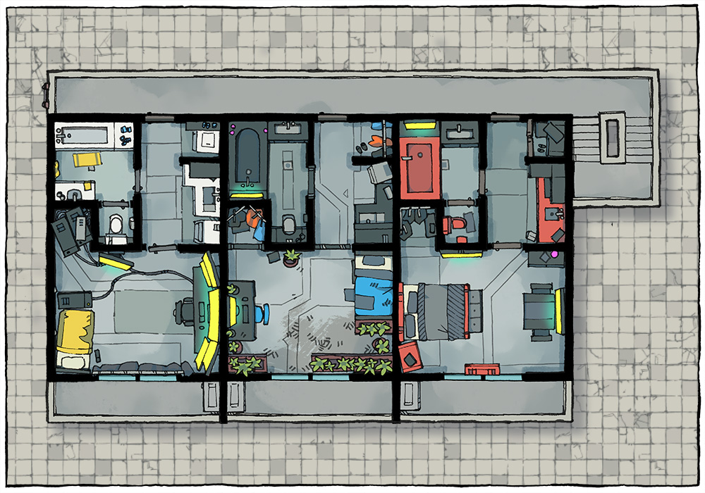
The Plot A corpo wants to repay one last favor to an old friend. The Job: Extract the target (Ruriko Takahasi) before they are eliminated by enemy runners. The Pay: 500¥ up front, 1000¥ for the target’s safety, bonuses for zero evidence (max 3k per player).
Scene 1 (Social). Setting: Ling Ho, a Yakuza controlled Chinese/Japanese restaurant, Downtown. The Hook: Runners were told by their fixers to meet here. Given dossiers with images, major skills, names of the rest of the team (have players introduce their characters). Events: Influence + CHA (3) – Maitre d' directs the player to a back room where Johnson-san. Johnson-san presents the job. Negotiation: per SMG p16, vs Influence 5 CHA 6, 5% increase/decrease in base pay per hit (max still 3k per SMG).
Scene 2 (Investigation). Setting: per players. Available Info:
Takahasi has recently published a series of articles highlighting poor living conditions in corporate controlled living quarters.
Takahasi was targeted by several smear campaigns in the past, but these only increased interest in her writing.
Takahasi recently graduated from Tokyo Daigaku with degrees in English Literature, Political Science, and Journalism. She's a minor celebrity and a darling in the investigative journalism world.
Takahasi's apartment building is protected by the Yakuza, but they've been recently "convinced" to slacken security. A hit on someone in the building is probably imminent.
(Difficult) A middle-management Aztecnology exec leaned on the Yakuza to allow the hit.
(Very Difficult) Takahasi dated Senjiro Masahara, now a rising exec in Renraku. They broke up over a year ago. (He is the client for this op).
Takahasi lives on the third floor of a five-story brownstone on the Seattle Waterfront. (Her apartment is the one on the left of the map). She spends much of her time at the media station, taking calls and investigating leads.
Optional Rules for Initiative. Purpose: Get all players involved in all scenes at First Taste. Social: Influence + CHA. # hits determines order. Ties: Edge, CHA, INT, Coin Flip. Investigation: Perception + INT. # hits determines order. Ties: Edge, INT, REA, Coin Flip.
Scene 3 (Investigation). Setting: The Apartment Complex. Edge: 1 per 2 successes in Scene 2 for each player (max 2). Challenges:
Takahasi's apartment is in a five-story on the waterfront Downtown. Security Rating A (CRB 239).
Matrix security is Rating A: Rating 6 host with Patrol and TarBaby (CRB 187) running. Next actions are to load Binder and Track, notify the spider, and hold the target for HTR.
Astral security has been weakened - watcher spirits and basic wards only.
Meatspace security has been weakened - a patrol of 2 people every 10 minutes.
Doors to the building have rating 4 SIN scanners against a known list of authorized guests and residents on the neighborhood host. A rating 3 chemsniffer is at the door; residents can bring chems in and out.
HTR is 30-60 seconds out if triggered and run by Lone Star (so normal response time).
Takahasi sees the impending hit and the extraction as signs she's onto something. She doesn't want to leave and must be convinced.
Scene 4 (Combat). Setting: The apartment. The opposing Shadowrunner team moves in for their kill and stumbles onto the PCs. Edge: 1 per player if they get advanced notice, 1 more (max 2) if they set up an ambush. Challenges: 1 enemy per player (max 4). Choose from these for stats, but flavor as opposing shadowrunners:
Patrolman (CRB 206),
Decker (CRB 205),
Combat Mage (CRB 206),
SWAT Officer (CRB 206).
Takahasi has 2 in all stats, Firearms 3 + Defiance Super Shock.
Picking Up the Pieces. Pay: negotiated pay. Max 3k per player. Karma: 3 karma for adventure survival.
Contacts: Ruriko Takahasi, Connections 2 Media Personality.
Selective Remorse
A Shadowrun 6e First Taste by Zeshan Rajput
CRB: Shadowrun 6th Edition Core Rule Book
SMG: Shadowrun Missions Guide v1.6
https://creativecommons.org/licenses/by-sa/3.0/
Map Credit: 2minutetabletop.com

